Slide 1

MUCIX(WEBSITE)
1. Patel Manan 196400307105
2. Patel Samarth 196400307112
3. Patel Khush 196400307100
4. Patel Kalp 196400307098

Slide 2
WORK DISTRIBUTION
Team Member 1 : Manan Patel.
Member Work : UI Design, Database Operations, Exception Handling.
Team Member 2 : Khush Patel.
Member Work : Design Flow , Email Password Reset.
Team Member 3 : Samarth Patel..
Member Work : Fields Data Flow, Datatype Classes.
Team Member 4 : Kalp Patel.
Member Work : UI Design, Documentation, Database operations

Slide 3
MUCIX
This is the music player website with the Interactive UI for the easy access for user. The key features are as follows.
It provides free no copyright music lists below and browse high quality, free non-copyrighted music by top artists.
Instead of downloading multiple apps and wasting all storage space, this proposal reduces the use of a lot of applications and will be a complete music solution.
It can be used easily for music and it’s convenient and quick, uses simple UI , in this music website we can play songs for free .
It provides the functionality like creating a playlist and also has search functionality which will the search the song and give the desired result.
It also provides the variety of Non-copyright songs .

Slide 4
OBJECTIVES
The main objective of the Online Music Portal is to manage :-
the details of Music,
Performer,
Album,
Customer,
Album Type.
It also manages all the information about Music, Track, Album Type.

Slide 5
Features Of Mucix
Features Of Online Music Portal Are As Follows:
Provides the searching facilities based on various factors. Such as Music, Album, Customer, Album Type
It tracks all the information of Performer, Track, Customer act Manage the information of Performer
It Shows the information and description of the Music, Album.

Slide 6
TECHNOLOGIES
CSS (FRONT END)
Java Script (J.S)
PHP
MY SQL (DATABASE)
APACHE
VISUAL STUDIO CODE(EDITOR)

Slide 7
DFD (Data Flow Diagram)
A data flow diagram (DFD) maps out the flow of information for any process or system.
It uses defined symbols like rectangles, circles and arrows, plus short text labels, to show data inputs, outputs, storage points and the routes between each destination.

Slide 8
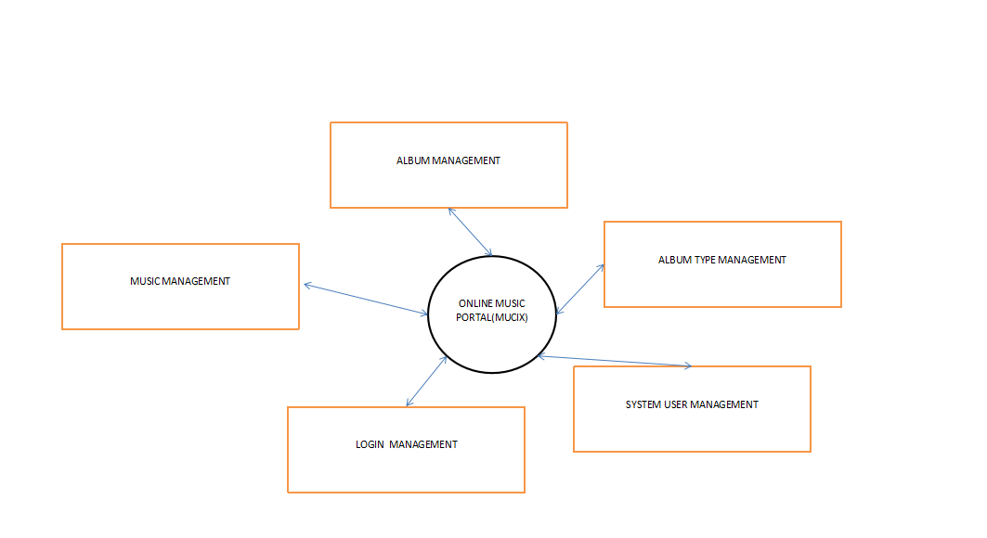
DFD LEVEL 0

Slide 9
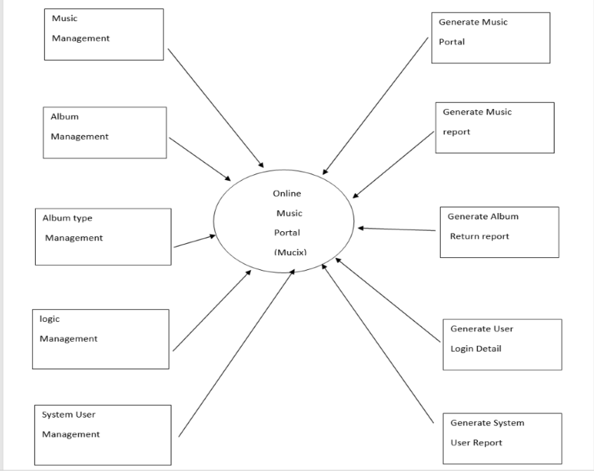
DFD LEVEL 1

Slide 10
DATA DICTIONARY
USERS:
Field Name | Data Type | Field Size | Constraint
id | Int | 11 | Primary Key
Username | Varchar | 25 | Not Null
Firstname | Varchar | 50 | Not Null
Lastname | Varchar | 50 | Not Null
Email | Varchar | 55 | Unique
Password | Varchar | 32 | Not Null
Signupdate | DateTIme | 30 | Not Null
Profilepic | Varchar | 500 | Not Null

Slide 11
DATA DICTIONARY
SONGS:
Field Name | Data Type | Field Size | Constraint
id | Int | 11 | Primary Key
title | Varchar | 50 | Not Null
artist | Int | 11 | Not Null
album | Int | 11 | Not Null
genre | Int | 11 | Not Null
duration | Varchar | 8 | Not Null
path | Int | 55 | Not Null
albumOrder | Int | 11 | Not Null
plays | Int | 11 | Not Null

Slide 12
DATA DICTIONARY
ARTISTS:
Field Name | Data Type | Field Size | Constraint
Id | Int | 11 | Primary Key
Name | Varchar | 50 | Not Null
ALBUMS:
Field Name | Data Type | Field Size | Constraint
Id | Int | 11 | Primary Key
Name | Varchar | 50 | Not Null

Slide 13
DATA DICTIONARY
GENRES
Field Name | Data Type | Field Size | Constraint
Id | Int | 11 | Primary Key
Title | Varchar | 50 | Not Null
Artist | Int | 11 | Not Null
Genre | Int | 11 | Not Null
ArtworkPath | Varchar | 255 | Not Null

Slide 14
SAMPLE CODE FRONT-END
html,
body {
padding: 0;
margin: 0;
height: 100%;
}
#background {
background-color: #000;
background-image: url(../images/black.jpg);
background-position: center;
background-size: cover;
display: table;
height: 100%;
width: 100%;
}
#loginContainer {
width: 80%;
margin: 0 auto;
position: relative;
max-width: 1024px;
}
#inputContainer {
width: 400px;
padding: 45px;
float: left;
border-right: 1px solid #999;
}
#inputContainer h2 {
text-align: center;
}

Slide 15
SAMPLE CODE BACK-END
<?php
include("includes/config.php");
include("includes/classes/Account.php");
include("includes/classes/Constants.php");
$account = new Account($con);
include("includes/handlers/register-handler.php");
include("includes/handlers/login-handler.php");
function getInputValue($name) {
if(isset($_POST[$name])) {
echo $_POST[$name];
}
}
?>
<?php
if(isset($_POST['registerButton'])) {
echo '<script> $(document).ready(function() { $("#loginForm").hide(); $("#registerForm").show();
});
</script>';
}
else {
echo '<script>
$(document).ready(function() {
$("#loginForm").show();
$("#registerForm").hide();
});
</script>';
}
?>

Slide 16
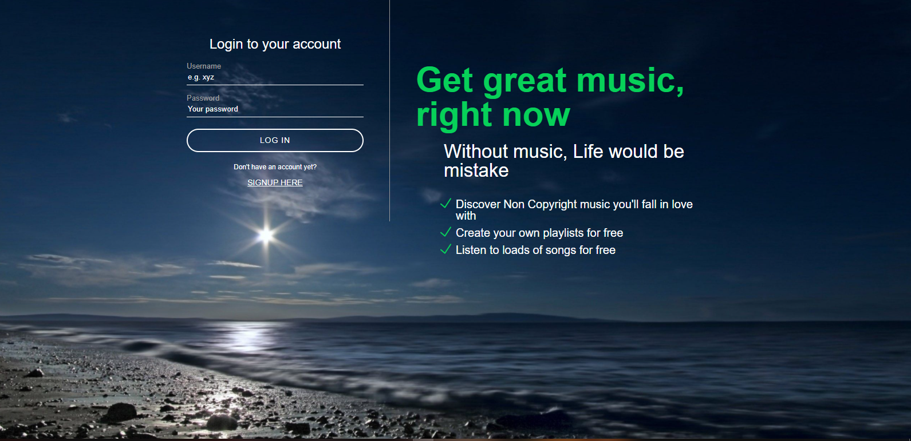
SCREENSHOTS

Slide 17
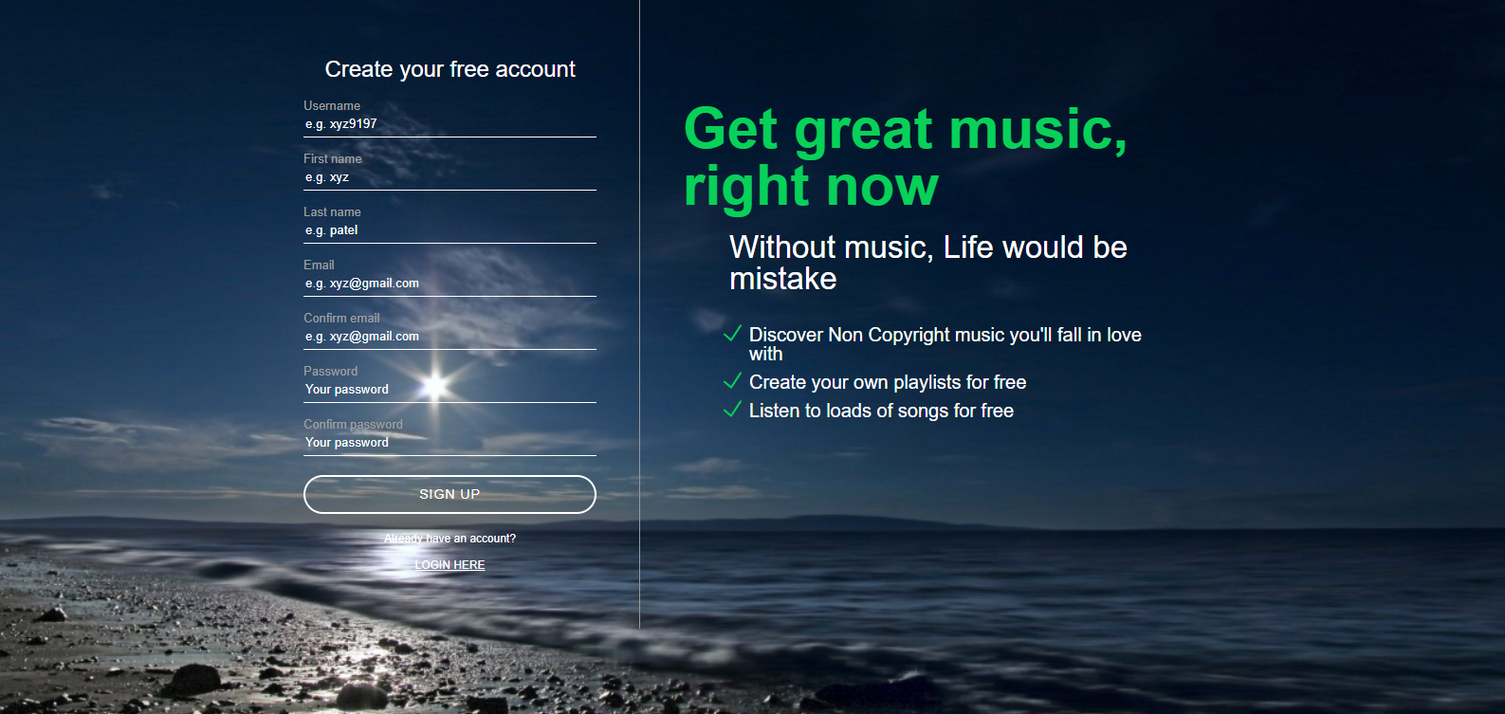

Slide 18
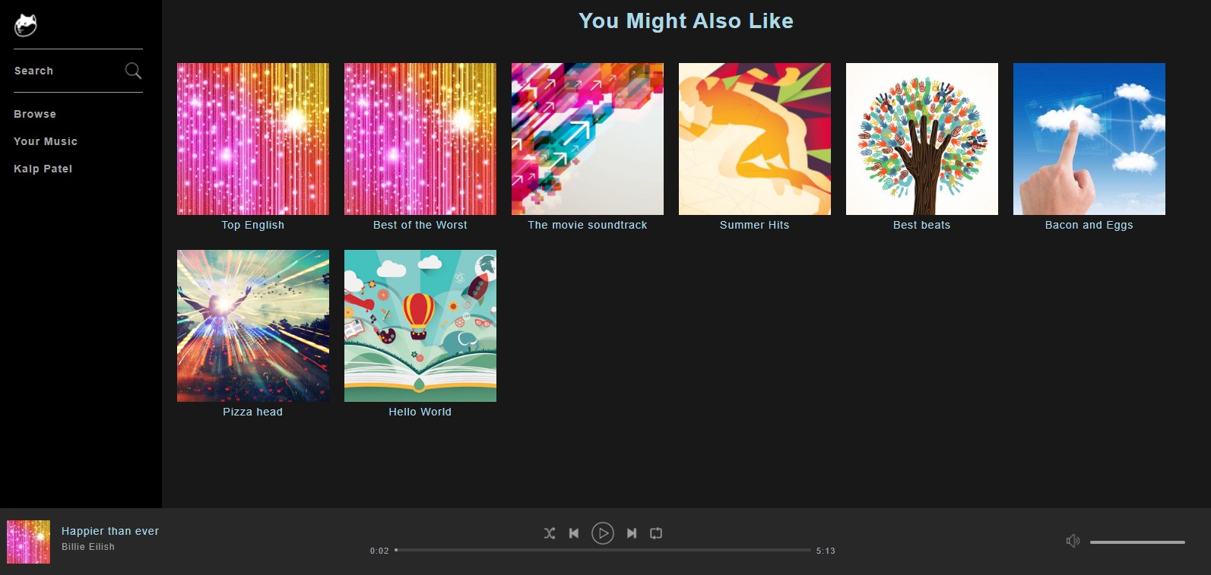

Slide 19
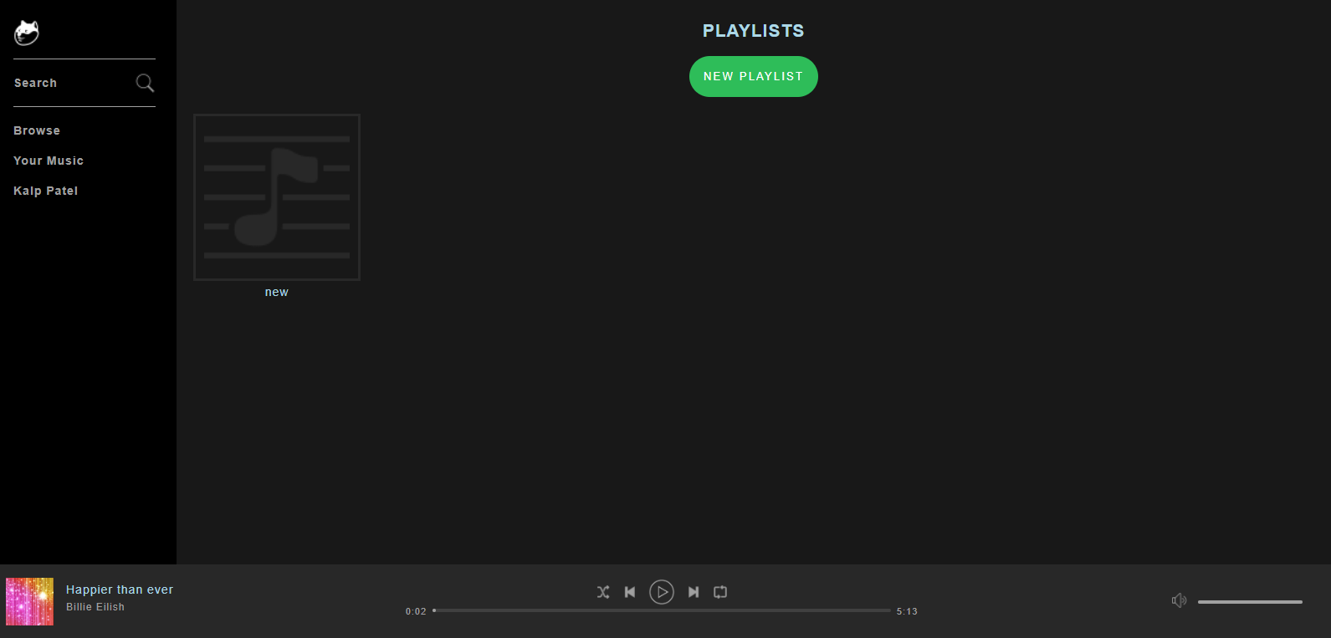

Slide 20
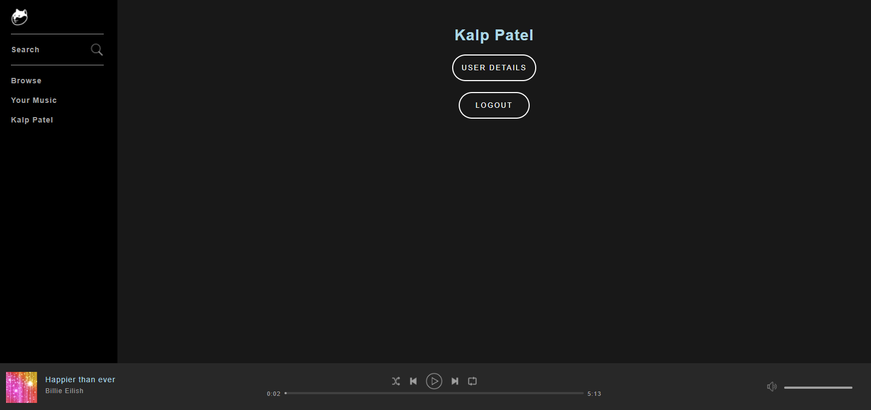

Slide 21
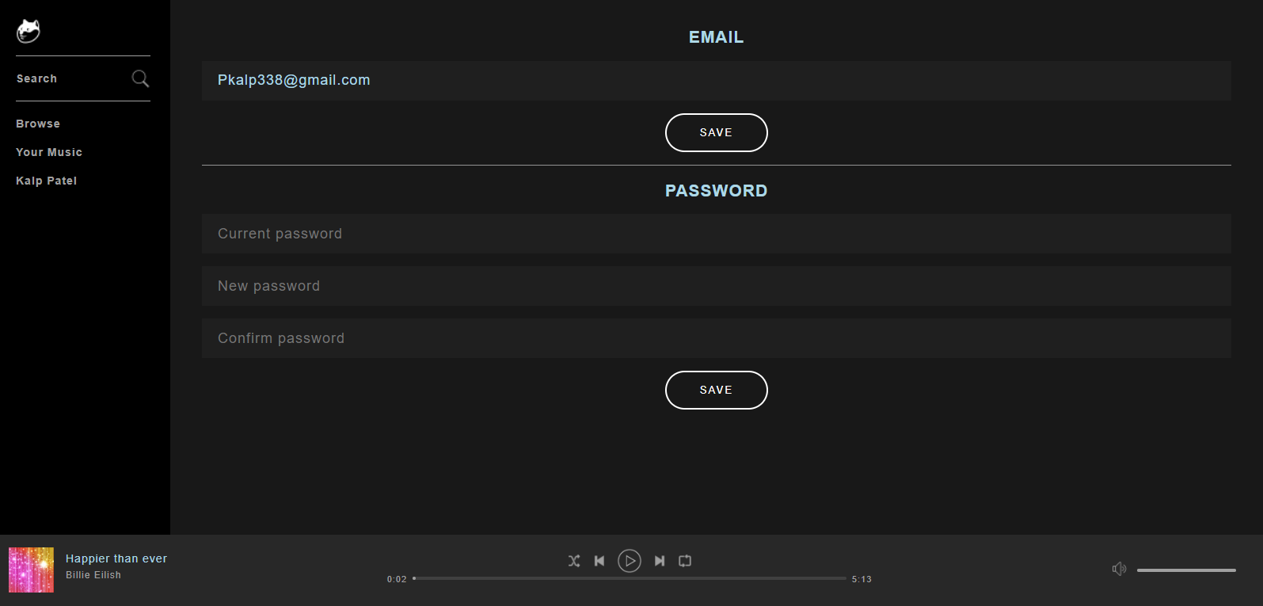

Slide 22
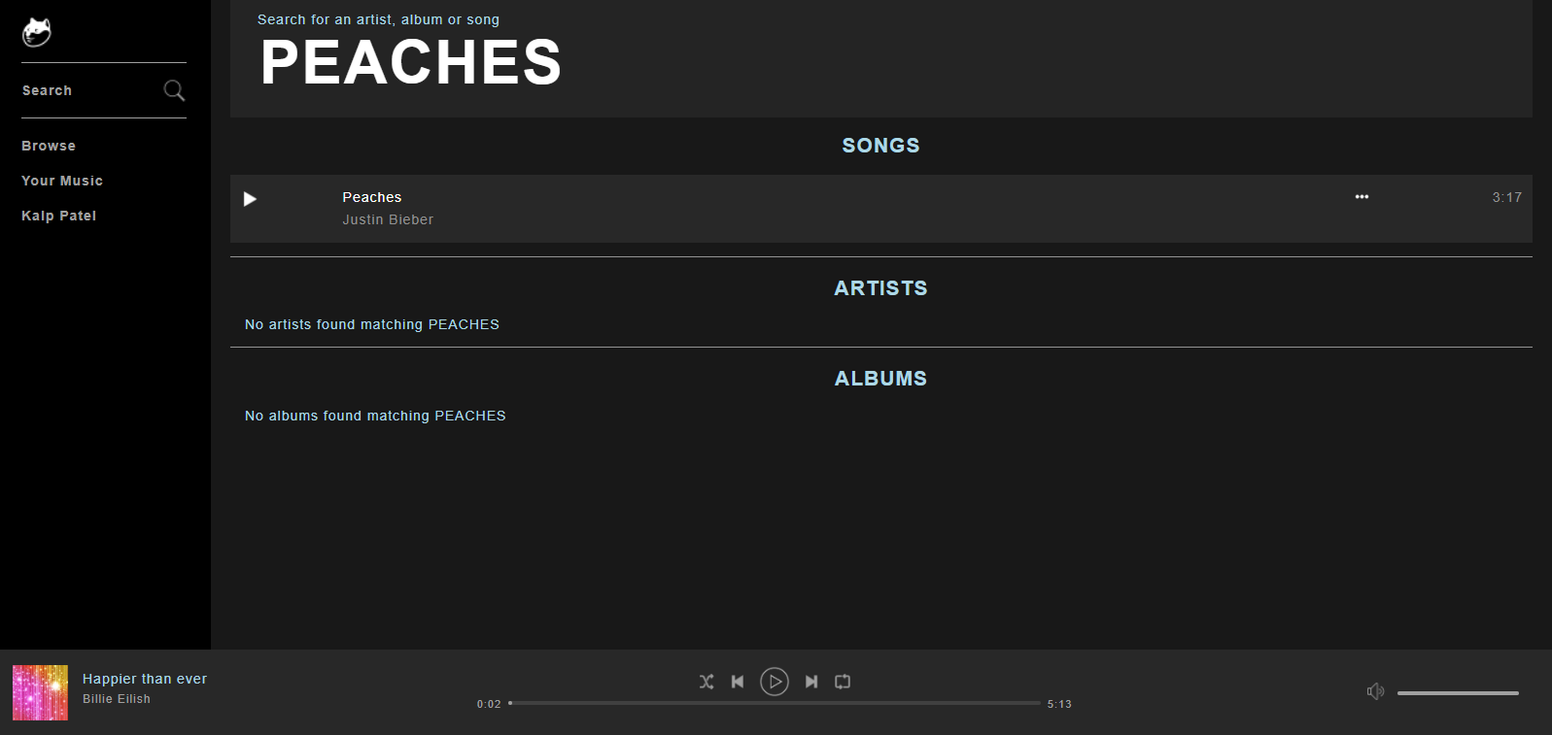

Slide 23
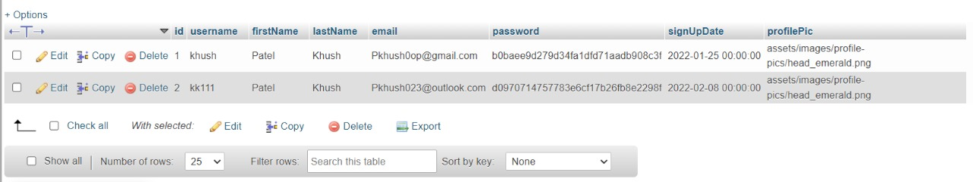
SCREENSHOT OF DATABASE AUTHENTICATION

Slide 24
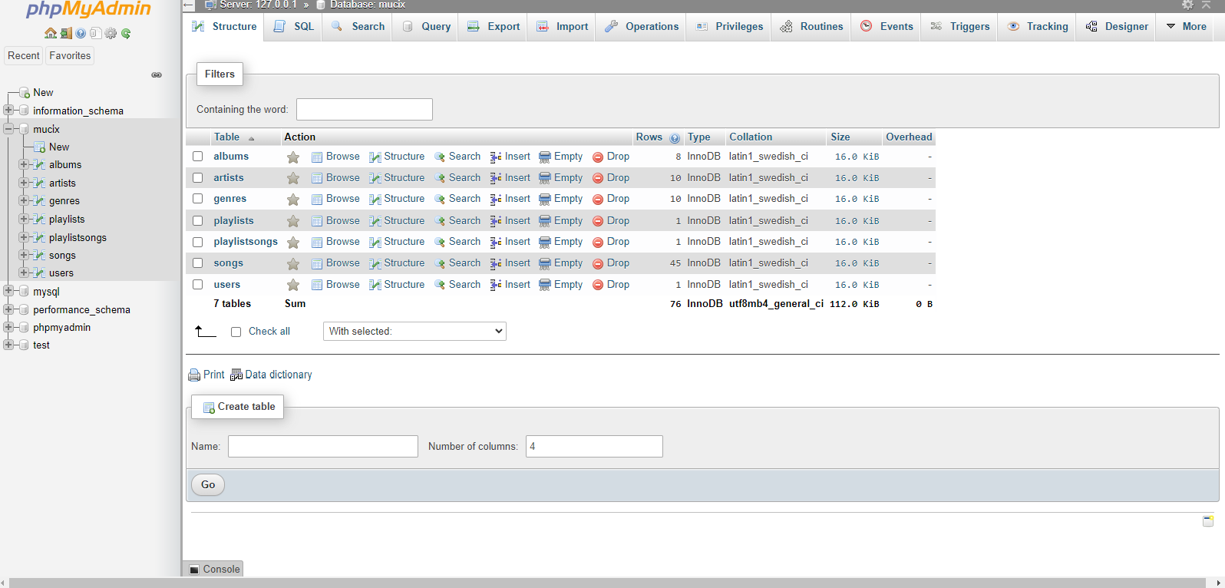

Slide 25
CONCLUSION
Streaming music, or more accurately streaming audio, is a way of delivering sound — including music — without requiring you to download files from the internet. Music services like Spotify, Pandora, and Apple Music use this method to provide songs that can be enjoyed on all types of devices.
Instead of downloading multiple apps and wasting all storage space, this proposal reduces the use of a lot of applications and will be a complete music solution.
In this music website we can play songs for free .
It provides the functionality like creating a playlist and also has search functionality which will the search the song and give the desired result.

Slide 26
\
THANK YOU

